Slide 1
Algorithm X
And the Dancing Link Technique
By: Cody Harrison

Slide 2
Introduction to Algorithm X
Algorithm X is a recursive, nondeterministic, depth-first, backtracking algorithm first thought of by Donald Knuth.
Knuth first mentioned it in his paper “Dancing Links” to describe his approach to find all solutions to the exact cover problem, however, Knuth’s intent was more to demonstrate the utility of his dancing links technique, also known as DLX, through its implementation in Algorithm X.

Slide 3

History of Algorithm X
Scientist and mathematician, Donald Knuth
The Art of Computer Programming by Knuth
Purpose of Algorithm X was to efficiently solve the NP-Complete exact cover problem.
The solution of an NP-Complete problem must be testable in polynomial time, however there is no known efficient way to solve the problem in polynomial time.

Slide 4
The Exact Cover Problem
The exact cover problem is a decision problem to find an exact cover. Given a collection S of subsets of set X, an exact cover is the subset S* of S such that each element of X is contained exactly once in the sub set S*. The subset S* should satisfy the following two conditions:
1) The intersection of any two subsets in S*should be empty
2) The union of all subsets of S* should contain all elements in set X exactly once

Slide 5
The Exact Cover Problem
For example, if set S = {A, B, C, D, E, F} and set X = {1, 2, 3, 4, 5, 6, 7} such that:
A = {1,4,7}
B = {1,4}
C = {4,5,7}
D = {3,5,6}
E = {2,3,6,7}
F = {2,7}
Therefore, the exact cover S* = {B, D, F} since every element in set X is present exactly once in subsets {B, D, F}.

Slide 6
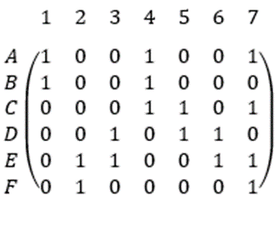
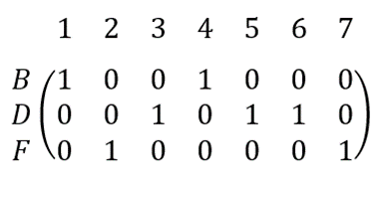
The Exact Cover Problem
A = {1,4,7}
B = {1,4}
C = {4,5,7}
D = {3,5,6}
E = {2,3,6,7}
F = {2,7}

Slide 7
Algorithm X
Algorithm X follows these steps to solve the exact cover problem in binary matrix form:
1) If matrix A has no columns left, the current partial solution is valid and terminates successfully
2) Otherwise, choose a column c deterministically
3) Choose a r such that A[r] = 1 nondeterministically
4) Put r into the partial solution
5) For each column j such that A[r][j] = 1,
For each row such that A[i][j] = 1,
Delete row I from matrix A.
Delete column j from matrix A.
6) Repeat this algorithm recursively on the reduced matrix.

Slide 8
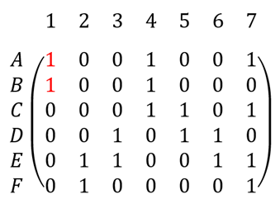
Algorithm X Example
Using the same matrix from before
Step 1) The matrix is not empty therefore proceed to step 2
Step 2) Choose the column with the lowest amount of 1’s in it. For our matrix that is column 1 and is selected deterministically

Slide 9
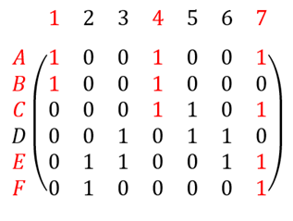
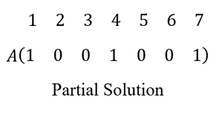
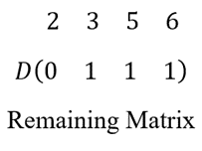
Algorithm X Example
Step 3) Rows A and B both have a 1 in column 1 and therefore A is chosen nondeterministically, the algorithm moves on to the first branch at the first level
Step 4) Row A is put into the partial solution
Step 5) Row A has 1s in columns 1, 4, and 7, therefore, we must delete columns 1, 4, and 7 and all rows that have a one in the same columns as Row A (A, B, C, E, F) since an exact cover can only have exactly one 1 per column
Step 6) Repeat the algorithm on the reduced matrix

Slide 10
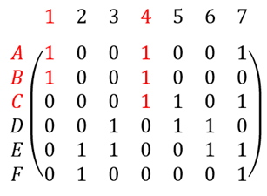
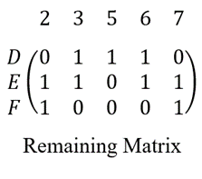
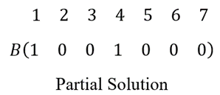
Algorithm X Example
Step 1) The matrix is not empty therefore continue onto Step 2
Step 2) The column with the least amount of 1s is column 2 with zero 1s, therefore this branch did not yield a solution and the algorithm must backtrack to the next branch.
Step 3) It will restore the matrix and this time pick row B instead of row A.
Step 4) Row B is put into the partial solution.
Step 5) Row B has 1s in columns 1 and 4, therefore we must delete columns 1 and 4 and all rows that have a 1 in the same columns as Row B (A, B, C)
Step 6) Repeat the algorithm on the reduced matrix.

Slide 11
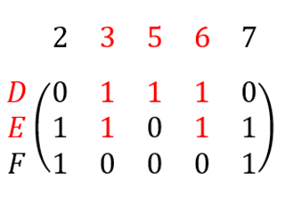
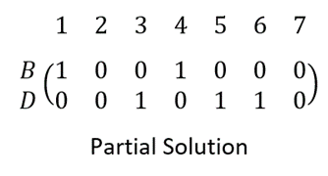
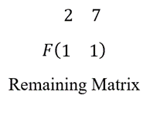
Algorithm X Example
Step 1) The matrix is not empty therefore continue onto Step 2.
Step 2) The column with the least amount of 1s is column 5.
Step 3) Row D has a 1 in column 5 and is therefore chosen.
Step 4) Row D is added to the partial solution.
Step 5) Row D has 1s in columns 3, 5, and 6, therefore we must delete columns 3, 5, and 6 and all rows that have a 1 in the same columns as Row D (D, E)
Step 6) Repeat the algorithm on the reduced matrix

Slide 12
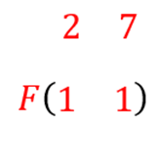
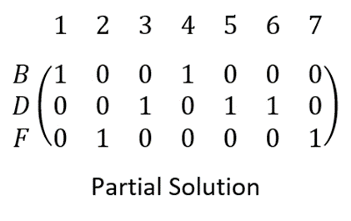
Algorithm X Example
Step 1) The matrix is not empty therefore continue onto Step 2.
Step 2) The column with the first least amount of 1s is column 2.
Step 3) Row F has a 1 in column 2 and is therefore chosen.
Step 4) Row F is added to the partial solution.
Step 5) Row F has a 1s in columns 2 and 7, therefore we must delete columns 2 and 7 and all rows that have a one in the same column as Row F (Figure 5.5)
Step 6) Repeat the algorithm on the reduced matrix.

Slide 13
Algorithm X Example
Step 1) The matrix is empty therefore the algorithm terminates successfully, and the partial solution is the solution. Every column has one and exactly one 1 in it, therefore {B, D, F} is our exact cover.
This is how Algorithm X solves the exact cover problem, however to do so there is a need for backtracking in case the first branch in the search tree does not yield a result. This is where the DLX technique shines.

Slide 14
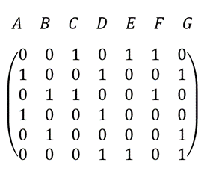
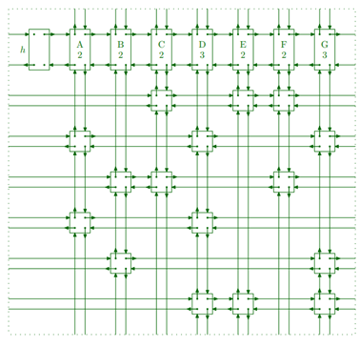
Dancing Links (DLX)
Given a binary matrix DLX represents the ones as data objects with fields L[x], R[x], U[x], D[x], and C[x]. These fields allow the node to point to adjacent nodes left, right, above, below, and the header column. Each row and column in the matrix will be a circular doubly linked list of nodes.

Slide 15

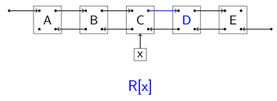
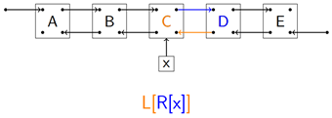
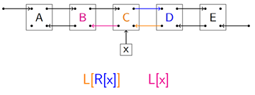
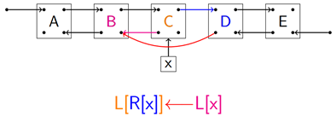
Dancing Links (DLX)
Two operations called covering and uncovering
Let x point to an element of a doubly linked list and B and D be data objects to the left and right respectively, then to remove the column x is in: x.left.right = x.right which, sets the right pointer of B to D, and x.right.left = x.left, which sets the left pointer of D to B. This process unlinks x from it left and right neighbors creating a skip in the link from B to D. Similarly, to remove a row x is in: x.up.down = x.down and x.down.up = x.up. This will unlink element x from its neighbors above and below.

Slide 16
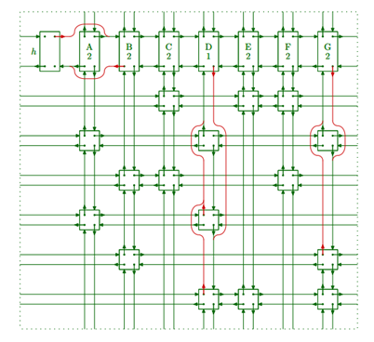
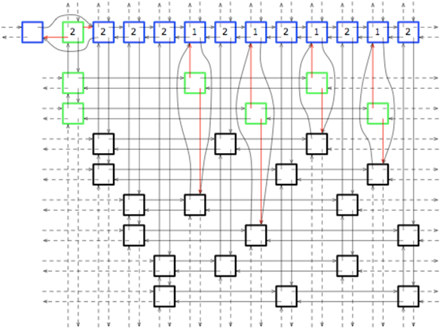
Dancing Links (DLX)
Let x point to an element of a doubly linked list and B and D be data objects to the left and right respectively, then to restore the column x is in: x.left.right = x which, sets the right pointer of B to x, and x.right.left = x, which sets the left pointer of D to x. Similarly to restore an x in a row: x.up.down = x and x.down.up = x. By applying these techniques to all elements in a row or column, any row or column can be unlinked or restored in the linked list, allowing us to test solutions and backtrack easily if they do not work out.
The name dancing links refers to the links "dance" with partner links so as to resemble an "exquisitely choreographed dance."

Slide 17
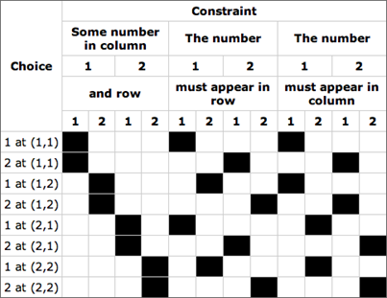
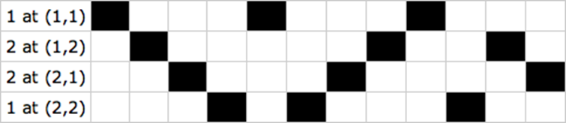
Applications
Various problems can be converted into an exact cover problem. Finding Pentomino tilings, solving Sudoku, and the N queens problem are a few examples. A 2x2 Latin square is a very small and simpler version of Sudoku. It is a 2x2 square in which the numbers 1 and 2 must be placed into the cells. There are three types of constraints:
1) There must be exactly one number per cell
2) There must be only one instance of a number per row
3) There must be only one instance of a number per column
There are three types of constraints and four constraints of each type since there are four cells total, for a total of twelve constraints. These constraints can be expressed as a binary matrix in which every possible option is shown, also known as a constraint matrix.
A typical Sudoku puzzle contains nine numbers to select from, nine rows, nine columns, and nine regions that can contain only one instance of a number. This would result in 324 constraints and 729 ways of placing a number. The constraint binary matrix of a 9x9 Sudoku puzzle would have 729 rows and 324 columns.

Slide 18
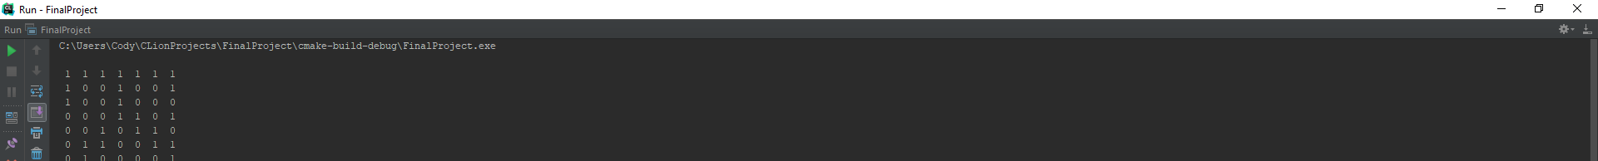

MY code output

